Slide 1
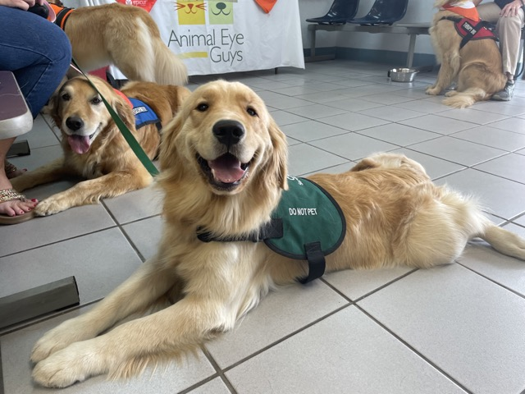
SERVICE & WORKING ANIMALS RECEIVE FREE SCREENING EYE EXAMS, MAY 2024
The ACVO/Epicur National Service Animal Eye Exam Event is a philanthropic event that provides free ocular screening eye exams to qualified Service and Working Animals each May.
These exams are provided by those members of the American College of Veterinary Ophthalmologists who choose to participate and volunteer their time and resources.
Register: April 1st – 30th, 2024 | Exams: May 2024
www.ACVOEyeExam.org

